Slide 1
Welcome to the 2018 Ladysmith Track & Field Awards Ceremony

Slide 2
Completion Award
Rising Star Award
Lettering Award

Slide 3
MS Girls 6th Grade Completion Award
Lila Baker
Kaylynn Bentley
Camryn Closs
Kloe Evjen
Kaelyn Grotzinger
Miranda Grotzinger
Breann Hillman
Abagail Morrisey
Taylor Ptacek
Shelby Smith
Katrina Stanger
Asialena Trindal
Khianna Vacho
Michelle Wallin

Slide 4
MS Girls 7th Grade Completion Award
Allison Clark
Emerson Clark
Michelle Gaddy
Ivy Nees
Elle Nisbit
Anna Rolli
Callie Rozak
Tristen Simon
Raemalee Smith
Victoria Thorpe

Slide 5
MS Girls 8th Grade Completion Award
Kendra Cigan
Anna Crick
Morgan Diamond
Alycia Ewer
Cora Gerber
Mikayla Izdepski
Payton Kell
Rachel Kostka
Holly Rands
Madison Read
Kamia Silva
Elizabeth Thorpe

Slide 6
MS Boys 6th Grade Completion Award
Riley Anderson
Kaden Becker
Ethan Cooper
Mateo DeJesus-Bowles
Weston Fuse
Talan Kell
Evan Loe
Hayden Stoneberg
Zach Wojcik

Slide 7
MS Boys 7th Grade Completion Award
Marcus Hanson
Elijah Hendrick
Brandon Kroening
Logan Poradish
Jeremiah Sanderson

Slide 8
MS Boys 8th Grade Completion Award
Isaac Cooper
Ashton Gwiazda
Bishop Peterson
Blake Prince

Slide 9
HS Girls Completion Award- Freshmen
Kylee Becker
Lacey Fuse
Kitara Fye
Erica Loe
Abby Meltz
Maddy Nybakke
Rachel Sovacool

Slide 10
HS Girls Completion Award- Sophomores
Madyson Clark
Faith Meltz
Kylee Millin

Slide 11
HS Girls Completion Award- Juniors
Brookelle Davis
Cassidy Stanger
Sarah Vollendorf

Slide 12
HS Girls Completion Award- Seniors
Catherine Cleveland
Megan Effertz
Serenity Hetke
Vanessa Loe

Slide 13
HS Boys Completion Award- Freshmen
Ren Nees

Slide 14
HS Boys Completion Award- Sophomores
Matt Diamond
Tru Dupee
Braden Evjen

Slide 15
HS Boys Completion Award- juniors
Connor Berg
Caden Dupee
Harvey Hill
Josh Jenness
Jacob Palumbo

Slide 16
All-Conference Honors

Slide 17
All conference honors 3rd place
Kylee Becker -100M Hurdles
Erica Loe - 800M Run
Brookelle Davis - 1600M Relay
Faith Meltz – 1600M Relay
Cassidy Stanger – 1600M Relay
Maddy Nybakke – 1600M Relay
Connor Berg – 3200M Run

Slide 18
All conference honors 2nd place
Mady Clark – 3200M Relay
Faith Meltz – 3200M Relay
Maddy Nybakke – 3200M Relay
Serenity Hetke – 3200M Relay
Brookelle Davis – 800M Relay
Abby Meltz - 800M Relay
Cassidy Stanger - 800M Relay
Kylee Millin - 800M Relay
Kylee Becker – 300M Hurdles

Slide 19
All conference honors 1st place
Erica Loe – 1600M Run
Caden Dupee -110M Hurdles
300M Hurdles
High Jump

Slide 20
Sectional Qualifiers

Slide 21
Sectional Qualifiers (Places 2nd - 4th)
2nd Place
4x800 Relay
Kylee Becker
Faith Meltz
Serenity Hetke
Maddy Nybakke
Mady Clark
Erica Loe
Caden Dupee
300M Hurdles
3rd Place
Caden Dupee
Triple Jump
Connor Berg
3200m Run
4th Place
Jacob Schilling
200m Dash
400m Dash
Megan Effertz
Long Jump
Sarah Vollendorf
Discus

Slide 22
Sectional Qualifiers Regional Champions
Kylee Becker
100m Hurdles
300m Hurdles
Caden Dupee
110m Hurdles
High Jump

Slide 23
STATE QUALIFIERS

Slide 24
Kylee Becker 300m Hurdles
Caden Dupee
300m Hurdles
Triple Jump

Slide 25
Girls Newcomer of the Year Award
Abby Meltz

Slide 26
Boys Newcomer of the Year Award
Tru Dupee

Slide 27
Girls Coach’s Award
Erica Loe

Slide 28
boys Coach’s Award
Jacob Palumbo

Slide 29
Girls MVP Award
Kylee Becker

Slide 30
Boys MVP Award
Caden Dupee

Slide 31
Scholar Athlete Awards

Slide 32
MS Girls Scholar Athlete Awards
Kendra Cigan
Morgan Diamond
Alycia Ewer
Cora Gerber
Mikayla Izdepski
Payton Kell
Rachel Kostka
Holly Rands
Madison Read
Kamia Silva
Elizabeth Thorpe
Allison Clark
Emerson Clark
Michelle Gaddy
Ivy Nees
Anna Rolli
Callie Rozak
Tristen Simon
Raemalee Smith
Victoria Thorp
Miranda Grotzinger
Khianna Vacho

Slide 33
MS boys Scholar Athlete Awards
Isaac Cooper
Bishop Peterson
Blake Prince
Elijah Hendrick
Brandon Kroening
Logan Poradish
Kaden Becker
Talan Kell
Evan Loe

Slide 34
HS Girls Scholar Athlete Awards
Kylee Becker
Erica Loe
Abby Meltz
Maddy Nybakke
Rachel Sovacool
Madyson Clark
Faith Meltz
Kylee Millin
Cassidy Stanger
Sarah Vollendorf
Catherine Cleveland
Megan Effertz
Serenity Hetke
Vanessa Loe

Slide 35
HS boys Scholar Athlete Awards
Matt Diamond
Tru Dupee
Caden Dupee
Jacob Palumbo
Connor Berg

Slide 36
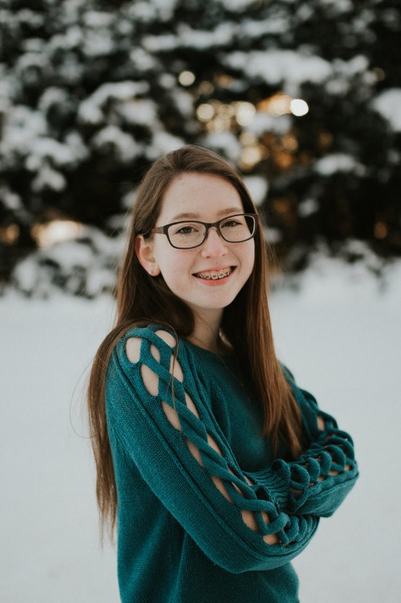
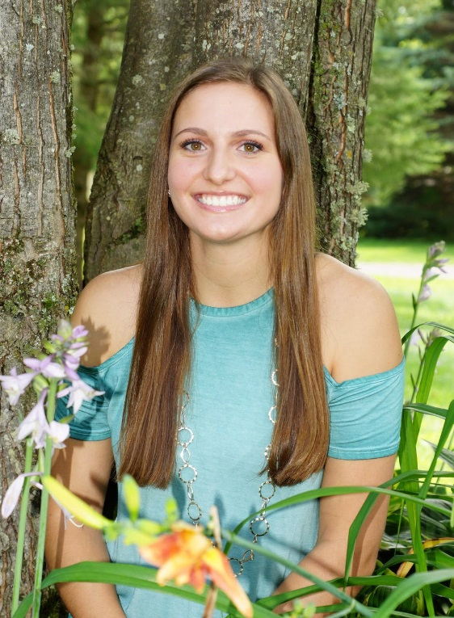
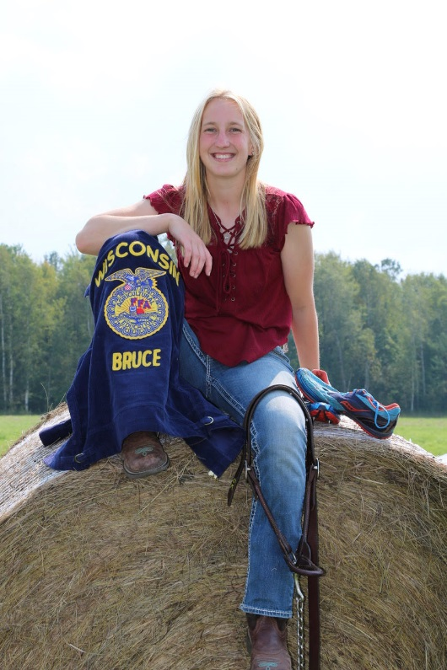
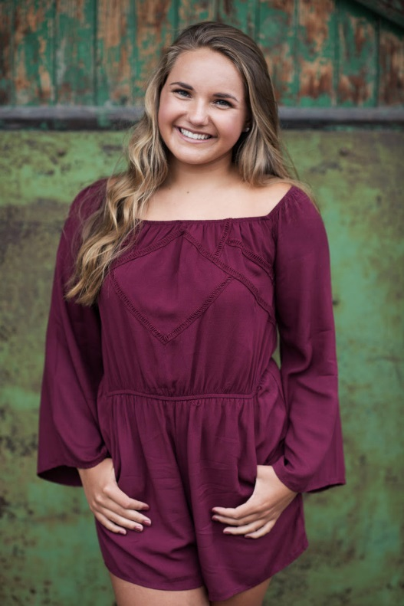
Senior awards
Catherine Cleveland
Megan
Effertz
Serenity
Hetke
Vanessa
Loe

Slide 37
Progression of the 5 Program
Each athlete will . . .
•Develop or enrich a strong work ethic, with an attention to detail, which can be applied to sports, academics, and future endeavors
•Develop or enrich a mental toughness that they can apply to various situations
•Maximize their own potential and in the process help others maximize their potential
•Realize that success is a process and doesn’t happen overnight
•Leave a better person than when they started
This is an award that’s inside of you, and only you truly know if you achieve it.

