Slide 1
to the 2017 Ladysmith Cross Country Awards Ceremony
Welcome

Slide 2
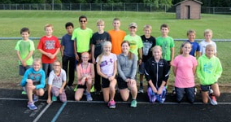
MS Season Awards
Participated - Finished the season, but didn’t complete and/or make-up all the required team events.
Completed - Finished the season and completed and/or made-up all the required team events
Rising Star Award –
Completed the season and
earned 50 or more wins

Slide 3
MS Girls Team
Payton Kell, 8 Lucy Becker, 6
Rachel Kostka, 8 Lauren Hanson, 5
Michelle Gaddy, 7 Grace Pearson, 5
Anna Rolli, 7 Kayleen Powell, 5
Payton Wold, 7 Rhea Woelfer, 5

Slide 4
MS Boys Team
Blake Prince, 8 Riley Anderson, 6
Marcus Hanson, 7 Mateo DeJesus-Bowles, 6
Brandon Kroening, 7 Evan Loe, 6
Eli Rogers, 7 Jaxen Donohue, 5
Jeremiah Sanderson, 7 Timmy Meltz, 5

Slide 5
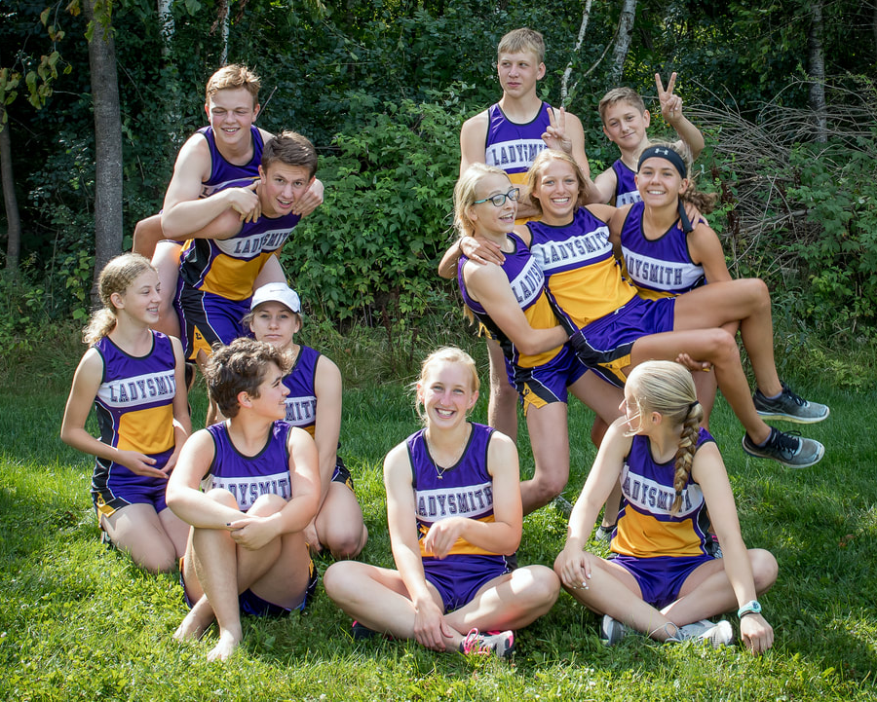
HS Season Awards
Participated - Finished the season, but didn’t complete and/or make-up all the required team events
Completed - Finished the season and completed and/or made-up all the required team events
Letter Award - Completed the season
and earned 50 or more wins

Slide 6
HS Girls Team
Serenity Hetke, 12
Brookelle Davis, 11
Kylee Becker, 9
Erica Loe, 9
Maddy Nybakke, 9
Ellie Poradish, 9
Esperanza DeJesus-Bowles, 9
Rachel Sovacool, 9

Slide 7
HS Boys Team
Christian Gomez, 12
Connor Berg, 11
Bryce Gudis-Steffen, 10
Bronson Davis, 9
Austin Kroening, 9

Slide 8
2000 Career Wins
Win - number of people you beat in a meet
Example: 15th/90 = 75 wins
Over a 4 year HS Career
Need an average of 500 wins per season
Need an average of about 50 wins per meet

Slide 9
2000 Career Wins Milestone
Connor Berg
2000th career win
on 10/3/17 at Hayward

Slide 10
2000 Career Wins Milestone
Serenity Hetke
2000th career win on 9/14/17 at Chetek
2500th career win at 10/28/17 at State

Slide 11
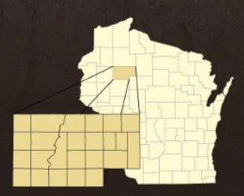
2017 All-Area Cross Country Recipients
Christian Gomez
Serenity Hetke
Connor Berg
Kylee Becker
Erica Loe

Slide 12
All-Conference Honors
Need to place in the Top 10 at the Heart of the North Conference Meet
2016 - Hosted by Cumberland
2017 - Hosted by Hayward
2018 - Hosted by Ladysmith

Slide 13
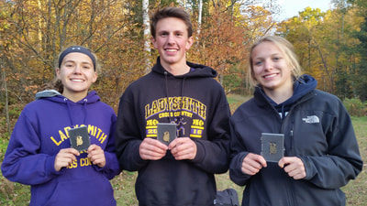
All-Conference Honors
Connor Berg - 1st Place (HON Boys Conference Champ)
Erica Loe - 1st Place (HON Girls Conference Champ)
Kylee Becker - 4th Place

Slide 14
State Qualifiers / WCCCA Academic All-State
State Qualifier - Top 2 teams and top 5 individuals who are not a part of a state qualifying team
WCCCA Academic All-State - Qualify for the State Meet and have a cumulative GPA of 3.5 or higher

Slide 15
State Qualifiers / WCCCA Academic All-State
Connor Berg –
Erica Loe –
Serenity Hetke -
Sectional Meet | State Meet
1st Individual State Qualifier | 35th Place in 17:26.31
Sectional Meet | State Meet
Sectional Champion | 7th Place in 19:44.34
Sectional Meet | State Meet
5th Individual State Qualifier | 73rd Place in 21:53.18

Slide 16
Newcomers of the Year
One of the top performers among first year athletes who best demonstrates leadership, positive attitude, great work ethic, and a team-first approach.

Slide 17
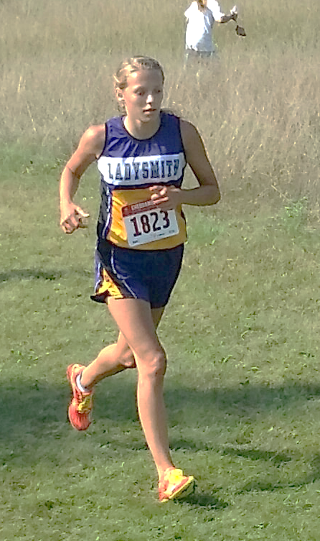
Girls Newcomer of the Year
Kylee Becker
452 wins this season
4th at Conference –
2nd highest finish for a Ladysmith
freshman CC runner
Missed qualifying for State by 3 places.

Slide 18
Boys Newcomer of the Year
Austin Kroening
429 wins this season
5th freshman boy to finish at Conference
8th freshman boy to finish at Sectionals

Slide 19
Coach’s Awards
Positive attitude, great work ethic, and does a lot of positive things for the team which may or may not go unrecognized.

Slide 20
Girls Coach’s Award
Serenity Hetke
905 wins this season
12th place finish at Conference
2017 State Qualifier
Finished 73rd at the State Meet
WCCCA Academic All-State

Slide 21
Boys Coach’s Award
Christian Gomez
738 wins this season
19/90 at Conference
Missed qualifying for State
by 7 places at Sectionals

Slide 22
MVPs
The athlete who adds the most value to the team. This is one of the top performers who best demonstrates leadership, positive attitude, great work ethic, and a team-first approach.

Slide 23
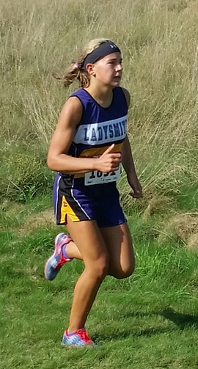
Girls MVP
Erica Loe
1051 wins this season
HON Girls Conference Champion
D3 Drummond Sectional Champion
Finished 7th at the State Meet
WCCCA Academic All State

Slide 24
Boys MVP
Connor Berg
844 wins this season
HON Boys Conference Champion
D3 Drummond Sectional Runner-up
Finished 35 at the State Meet
WCCCA Academic All-State

Slide 25
Scholar Athletes
Earn Letter or Rising Star Award
1st Quarter GPA of 3.25 or higher

Slide 26
MS Girls Scholar Athletes
Payton Kell, 8
Michelle Gaddy, 7
Payton Wold, 7
Lucy Becker, 6
Lauren Hanson, 5
Grace Pearson, 5
Kayleen Powell, 5
Rhea Woelfer, 5

Slide 27
MS Boys Scholar Athletes
Blake Prince, 8
Marcus Hanson , 7
Eli Rogers, 7
Evan Loe, 6
Jaxen Donohue, 5
Timmy Meltz, 5

Slide 28
HS Scholar Athletes
GIRLS
Serenity Hetke, 12
Kylee Becker, 9
Erica Loe, 9
Maddy Nybakke, 9
Ellie Poradish, 9
Rachel Sovacool, 9
BOYS
Christian Gomez, 12 Connor Berg, 11

Slide 29
Senior Awards
Christian Gomez
1438 Career Wins
2 Time Letter Winner

Slide 30
Senior Awards
Serenity Hetke
2017 State Qualifier
2016 All-Conference
2531 Career Wins
4 Time Letter Winner

Slide 31
Progression of the 5 Program Goals Award
Each athlete will . . .
•Develop or enrich a strong work ethic, with an attention to detail, which can be applied to sports, academics, and future endeavors
•Develop or enrich a mental toughness that they can apply to various situations
•Maximize their own potential and in the process help others maximize their potential
•Realize that success is a process and doesn’t happen overnight
•Leave a better person than when they started
This is an award that’s inside of you, and only you truly know if you achieve it.

Slide 32
